Slide 1


Strictly Private and Confidential
Development of Energy Plan and Energy Action Plan for the state of West Bengal
August 2018
Deloitte Touché Tohmatsu India LLP

Slide 2
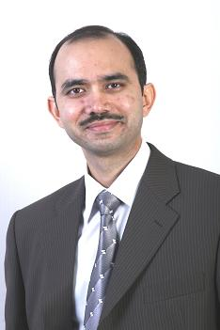
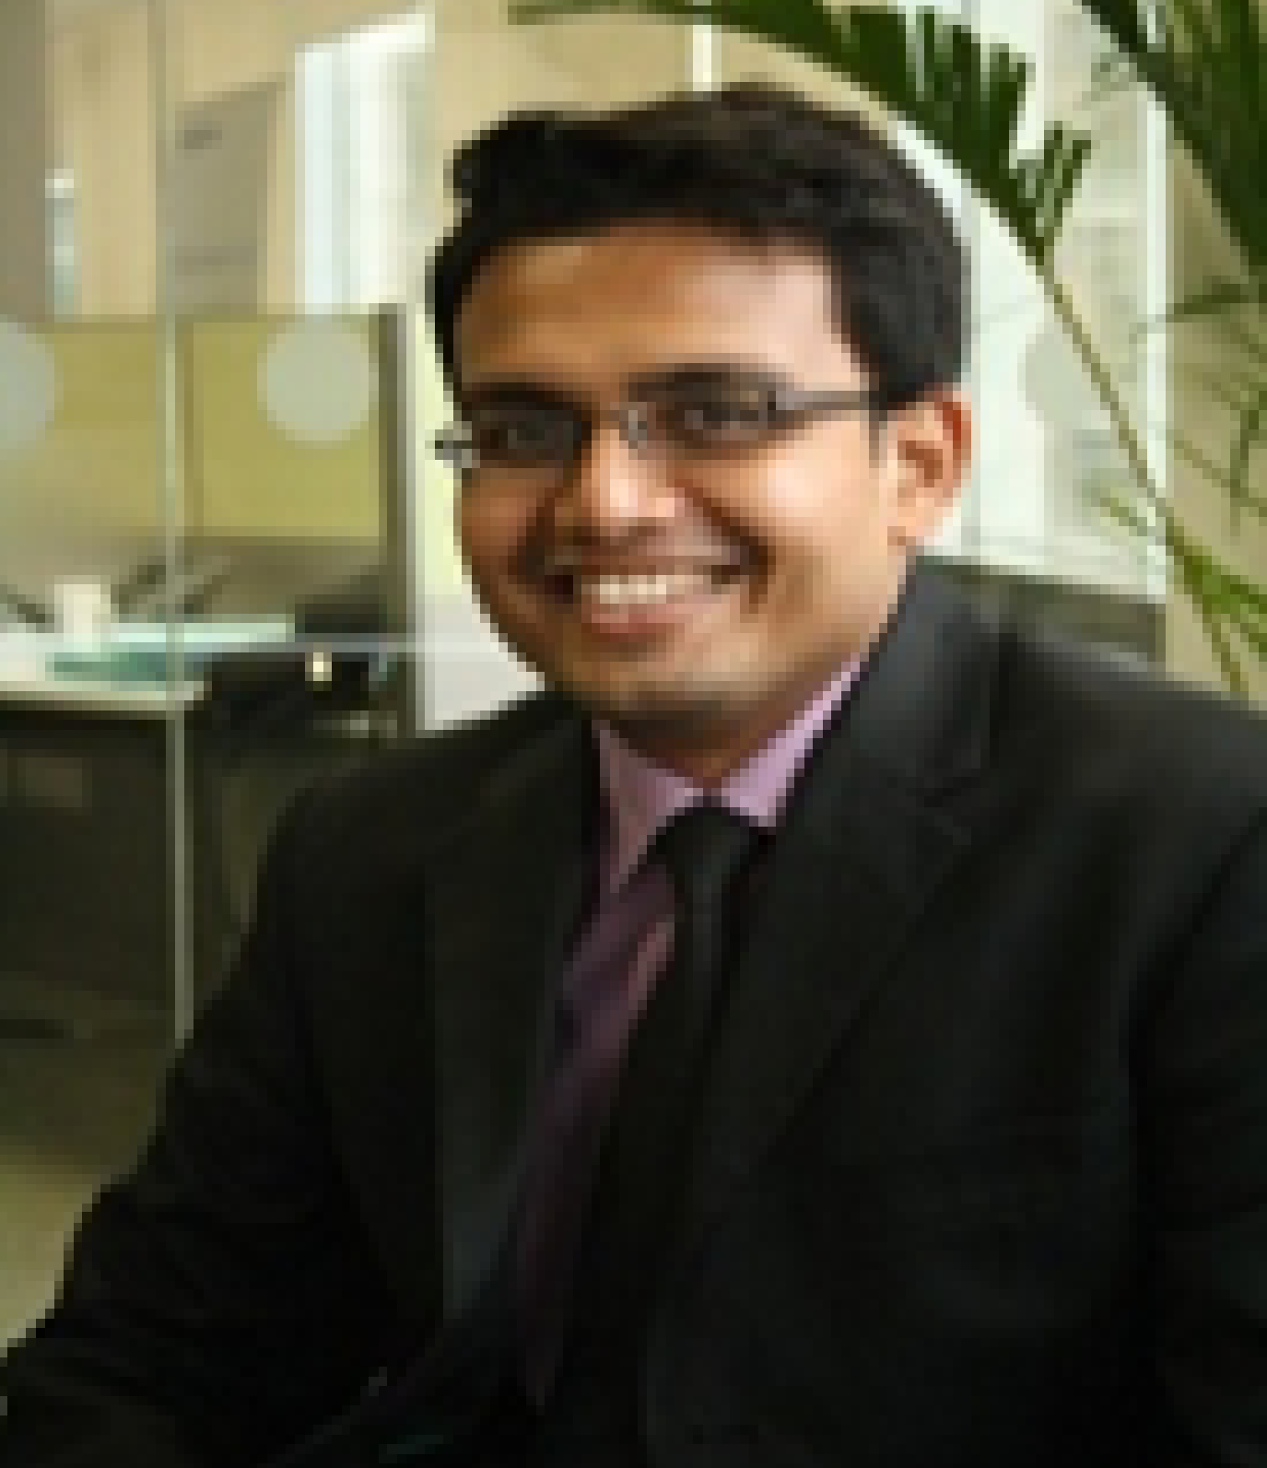

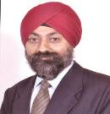
Our Team Today
Shubranshu Patnaik
Partner & Energy Sector Expert
Anish Mandal
Director & Power Sector Expert
Sayantan Banerjee
Director & Energy Sector and Liasing Expert
Dr. Indrajeet Singh
Director & Climate and Energy Efficiency Expert

Slide 3

Agenda
Deloitte and E3 advantage
Understanding the objectives of Integrated Energy Plan
Our Approach & Methodology
Resource Plan Strategy

Slide 4

01
Deloitte & E3 Advantage

Slide 5
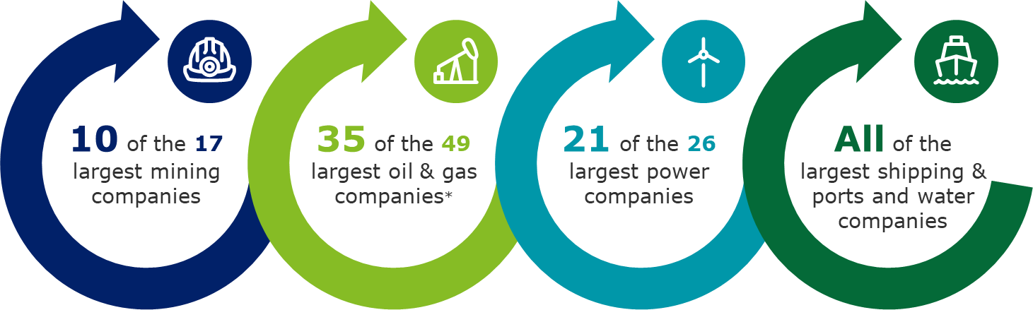
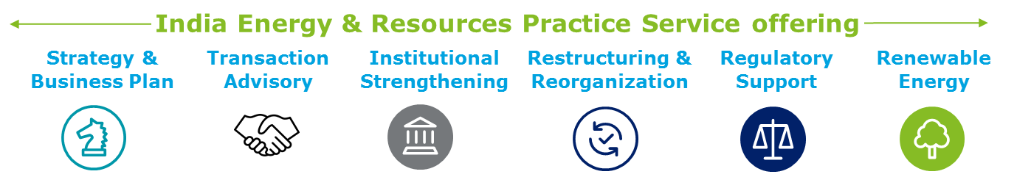
About Deloitte
Deloitte is the world's largest professional services firms; our consulting practice has been rated #1 globally by multiple analysts
Deloitte serves 73% of the 95 Fortune Global 500 companies operating in Energy and Resources space
263,900+ professionals
Located in 154+ countries
Revenue of
US$ 38.8 billion
For the fifth consecutive year, industry analysts have maintained their perspective on Deloitte Consulting practices globally..
Globally in Consulting based by Gartner
A worldwide leader
in Business Consulting Services based on capability and strategy by IDC MarketScape
#1
Deloitte in India
Our Presence in West Bengal-
With 350+ professional strength and 30+ professionals focusing exclusively in Energy & Resources, Deloitte in Kolkata brings unparalleled experience and exemplary relationships with Government of West Bengal
30,000+ professionals
across 13 locations
120 years of successful client service
Gurgaon
Ahmedabad
Jamshedpur
Baroda
Mumbai
Pune
Kolkata
Goa
Hyderabad
In India, Deloitte serves 36 of 52 BT500 Energy & Resources Companies.
Bengaluru
Chennai
Kochi
Coimbatore
Right combination of global talent and expertise with regional experience and local insights

Slide 6
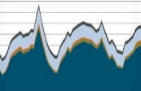
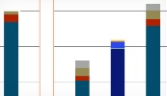
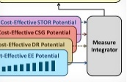





About E3
E3’s modeling expertise extends to both energy system models and more specific modeling tools used in the electricity sector
Energy and Environmental Economics, Inc. (E3) is a fast-growing energy consulting firm Founded in 1989 Based out of San Francisco, California. It has international presence in China, India, the Middle East, United states & South Africa.
Asset valuation
ACM: Avoided Cost Model
Electric Vehicle Grid Impacts Model
Distributed energy resources
Electricity markets
IDSM: Integrated Demand Side Mnmgt Model
REFLEX: Renewable Energy Flexibility Model
RESOLVE: Renewable Energy Solutions Model
Core areas
PATHWAYS Model
Clean energy
Rate design
RECAP: Renewable Energy Capacity Planning Model
RESTORE: Energy Storage Dispatch Model
Planning
electricity
E3 Global Experience
U.S. States | Support to NYSERDA in developing a detailed greenhouse gas (GHG) analysis with cost implications in different scenarios by using LEAP for continued use.
California | Supported development of the state’s 2030 GHG targets and the California Air Resources Board’s 2017 Climate Change Scoping Plan, UN Deep De-carbonization Pathways Project.
India | Supporting the development of long-term planning tools for electricity distribution utilities.
China | Energy sector support & technical assistance to SERC’S GHG targets for the electricity sector. Study on engaging utilities in Transportation Electrification in The US, Europe and China.
Mongolia | Renewable energy cost model and power purchase agreement training for Mongolia
Oregan | Supported Oregon Department of Environmental Quality in performing economic analysis of a market-based carbon reduction program by energy-accounting model LEAP and the impacts of the carbon market using the IMPLAN macroeconomic model.

Slide 7
Our Credentials
We have worked on multiple engagements and have served clients across the globe
Our major experience in the Asian Countries
Greenhouse gas mitigation planning in China’s electricity sector.
Future directions for grid planning and renewable energy development to meet goals in India.
electricity price forecasting study in Turkey.
Developing a strategy for low emission & Increasing energy efficiency adoption and compliance in energy-intensive sectors in Vietnam.
Demand Assessment for oil and gas products in India.
Increase institutional capacity by imparting training to NEA employees in Nepal.
Development of an RE integration plan with the implementation strategy in Maldives.
Projections of regional energy requirements till 2030 in South East Asian countries.
Energy Plan & Integrated Energy Modelling
Energy Related Programme or policies
Energy Planning/Modelling tools/softwares
Training & Capacity Building
Our major Global experience
Drafted the 2007 Idaho Energy Plan in USA.
exploring the feasibility, timing, and cost of achieving a 100% renewable energy future in New York.
Studied scenarios for achieving deep decarbonisation in U.S.
Investigation of Least Cost Policy Decisions to Achieve Hawaii’s Renewable Portfolio Standard (RPS) Goals.
Design 2025 Energy Policy in Angola.
Impact assessment and economic forecast for energy consumption in Belgium
Gather energy consumption and GHG data and energy costs to Develop a framework to meet the energy reduction target in Canada.
Long-term Forecasting Model (LFM) to Produce annual forecasts out to 20 years in Australia.
Sustainable Energy Model development for Spain in 2050.
Liaison experience with Government Departments
Official Developmental Assistance

Slide 8


































Our Credentials
We have worked on multiple engagements and have served clients across the globe
Countries we have served
China
India
Turkey
Myanmar
South East Asia
Nepal
Hawaii
United States
Spain
Canada
Australia
Zimbabwe
Belgium
Jamaica
Clients we have served

Slide 9
Our Credentials
We have extensive experience with Eastern States of India and have in depth understanding of the entire Energy sector of West Bengal
WEST BENGAL
Preparation of Power For All Roadmap for the State of West Bengal.
Designing Integrated Skill Development Scheme of Ministry of Textiles in 2015.
Development of an electricity demand model with sensitive analysis basis consumption patterns, State’s projected GDP and various schemes.
Advisory Services for Preparation of MYT Petition WBSEDCL.
Development of Vision, Mission and Long and Short Term Perspective Plans for Department of Planning, Statistics & Programme Monitoring.
Retainer ship services for providing assistance to WBSEDCL in all regulatory areas
Revival of Ceramic Centre for Rural Development for Department of MSME and Textiles
Other Eastern States
Assistance to JBVNL in Monitoring of PFA, UDAY and Similar Schemes of Central and State Government.
Odisha Street Lighting Greenfield project on PPP
Assistance to Odisha’s Nodal agency for Solar (GEDCOL & OREDA) on various solar PV assignments.
Assessment of Renewable Energy Technology Deployment under Enhancing Teacher Effectiveness in Bihar.
Institutional strengthening of Jharkhand Discom and Transo
Regulatory assistance to the BSPHCL/ erstwhile BSEB in filing Business Plan and tariff petitions and performing voltage wise CoS study

Slide 10
02
Understanding the objectives

Slide 11
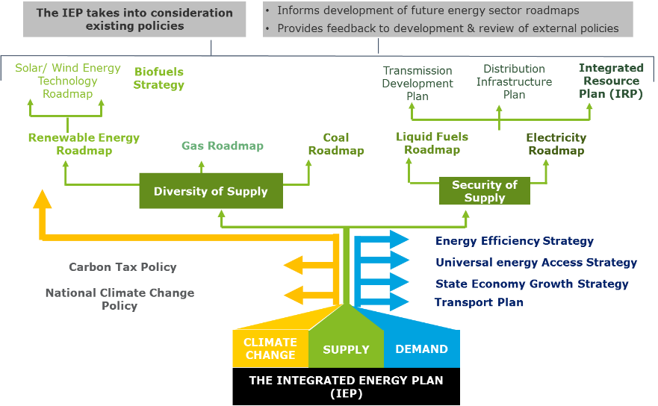
Energy Action Plan for West Bengal
Integrated Energy Planning intends to meet the energy demand in a safe and environmentally sustainable manner
Objectives of Energy Plan
Economic Development
Promote Energy Access
Promote Energy Efficiency
Social Development
Ensure security of supply
Promote job creation and localization
Minimize cost of energy
Environmental Sustainability
Diversify Supply Sources
Minimize water consumption
Minimize environmental impacts

Slide 12
03
Approach & Methodology

Slide 13
Energy Action Plan for West Bengal
A focused, systematic and dedicated approach will be critical for developing the State Energy Action Plan
Setting the objectives and vision for the states
Analyzing
Alternate Pathways and scenario development
3. Developing the Action Plan and consensus building
Document strategic direction and objectives
Changing context and disruptions; new market model and technologies
Extensive Stakeholder engagement and coordination across Ministries and Departments
Plan
objectives
Clean
Affordability
Least Cost
Efficiency
Training need analysis and orientation with tool
Understanding expectations and setting boundary conditions
Self sufficient
Sustainable
Desk Review of Existing Policies, Plans and Schemes
Agenda-setting
Stakeholder Analysis
Mapping Inter-departmental Linkages
Preparation of Database formats and baseline assessment
Assumption building and database creation
Identify policy alternatives, new technology paths and priorities
Integrated energy modelling and Least Cost Optimization
Simulation of various Scenarios and key policy decisions
Stakeholder Consultation
Decision Support Tool
Capacity Building of PMU
Evaluate strategic options and impact analysis
Preparation of State Energy Action Plan and consensus building
Generation of time step wise activities
Obtaining approval anf defending the action plan
Capacity Building of PMU members for Monitoring and Evaluation of State Energy Action Plan
Strategic
analysis
and Key Activities
Project management
Monitoring and Execution, Stakeholder Engagement and Training of Project Monitoring Unit (PMU)

Slide 14
Energy Action Plan for West Bengal
Work Package-I: Context Setting and Determining the State Vision
The present work package will commence from identification of key data inputs, initiation of data requirements request and scheduling the interview with Stakeholders
Project Structuring – Finalization of Work plan
Engage and Sensitize the Stakeholders
Impart training on Energy Plan / Energy Action Plan and need for an integrated plan for long-term sustainability and environment safeguard
Detailed work plan will be prepared in coordination with DPNES, GIZ and the constituted Project Management Unit (PMU)
Stakeholder Discussions
Training Need Analysis
Analyze the existing knowledge and skill gaps of PMU members necessary for required inputs
Identification of State Dept. and nodal entities
Training to PMU members on key data interchanges necessary for EAP development
Objective of Trainings/ Workshops
Building consensus on Vision, Goal and Action Plan
Engage various departments for discussing and building consensus on vision, goal and actions required under the Energy Action Plan
Development of Vision & Goals for Energy Plan
Strategy and vision workshops
iterative sensing of the external environment and the internal capabilities for goal development
Promote Cooperation and Coordination
Facilitate collaboration and coordination amongst the various departments in policy formulation and decision-making
Deliverable for WP-I: Report comprising of approved EAP vision and goals, approved project timelines and structure, responsibility mapping

Slide 15
Energy Action Plan for West Bengal
Work Package-II: State Energy Database Preparation- Determining key industries having participatory role in determining the overall energy consumption of the State
Energy Consuming sectors
Quantity based indicators
Transformation indicators
Other elements
Industry segregated by end product and production quantum; electricity consumption and energy as feedstock (coal, gas, wood, etc.) | Industrial output growth projection, new industries, obsolescence; energy efficiency schemes, policies, etc. | New technology developments and their effect is energy consumption – like paper industry consuming wood as feedstock;
Urban-rural divide, no. of households using different cooking sources, quantum consumed, etc. | Central schemes, state incentives, LPG penetration, etc. | Economic shifts of population strata, income distribution, cost implications.
No of mobile towers in the state | New technology shifts, future requirements, new business models | RE potential, fuel alternatives, telecom technology choices
No of efficient and non-efficient street lights | Average consumption/ light | Cost implications, business models, etc.
No of efficient and non-efficient pump sets; crop patterns, seasonality index, etc. | Energy efficiency schemes and policies, Distributed RE schemes and incentives, technologies | Changes in global agricultural practices, predicting the contribution of agricultural in state economy, etc.
Applicability of Cooling and heating applications, lighting appliances, etc. | Building bylaws, building efficiency norms and policies, change is technology | Urban development, affordable housing, smart cities, etc.
No of vehicles, vehicle types, person-kms, running efficiency (km/l), etc. | How shifts will happen between each transport mode based on technology and cost choices | New technologies, infrastructure support requirements, cost implications.
Industry
Cooking
Telecom
Municipal
Agriculture
Buildings
Transport

Slide 16
Energy Action Plan for West Bengal
Work Package-II: State Energy Database Preparation- An illustration of framework development of the database for transport sector
We propose to segregate the various modes of transportation further into category of vehicle along with fuel sources to determine the most accurate energy demand for the sector
Transport sector of West Bengal
Category
Domestic
Commercial
Public Transport
Shipping
Modes of transportation
2-Wheeler
4-Wheeler
LCVs
HCVs
3-Wheelers
Metro
Bus
Tram
Pre-paid Taxi
Ferry
Air services
Ships
Fuel source
Key Indicators for energy demand computation
Running efficiency (km/l) (Source- ARAI)
No. of vehicles registered with vehicle types (Source-Department of Transport, West Bengal; Vahan Dashboard)
Vehicle kilometer travelled (VKT) for each mode (Source-Department of Transport, West Bengal,
Fuel wise energy consumption
(Giga Joule)
Development of new corridors, state highways, roads, etc.
Increase in number of fleet strength
Increase in number of clean fuel transportation
Increase in Metro development
Shift in choices of mode of transport based on technology and cost choices
Emergence of new technologies
Jetty development
Increase in helipad development
Increase in construction of ships, safer boats
Other baseline parameters
Electricity
CNG
Petrol
Diesel
Aviation oil

Slide 17
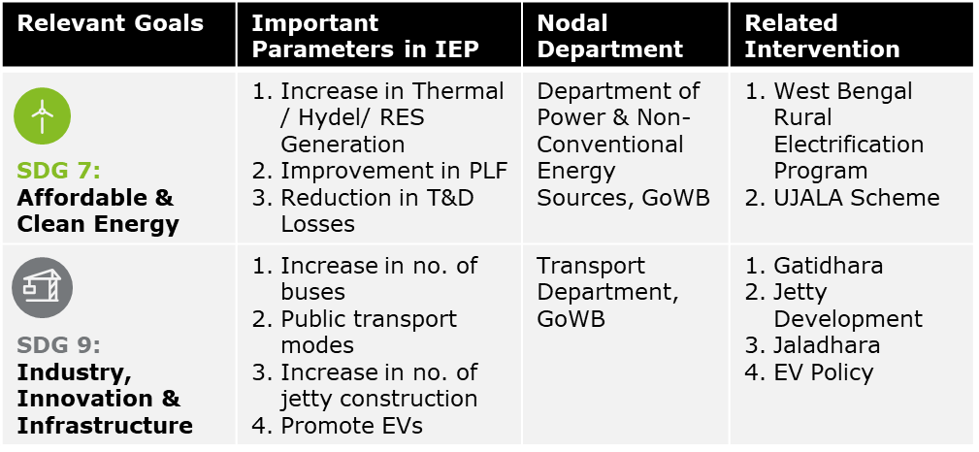
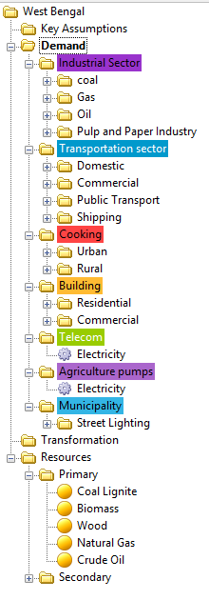
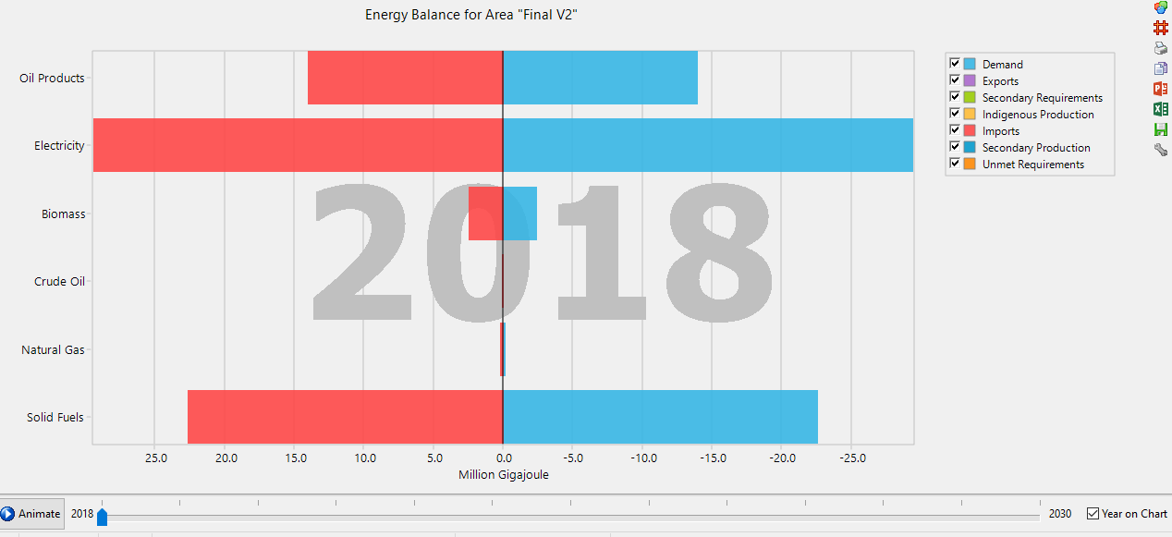
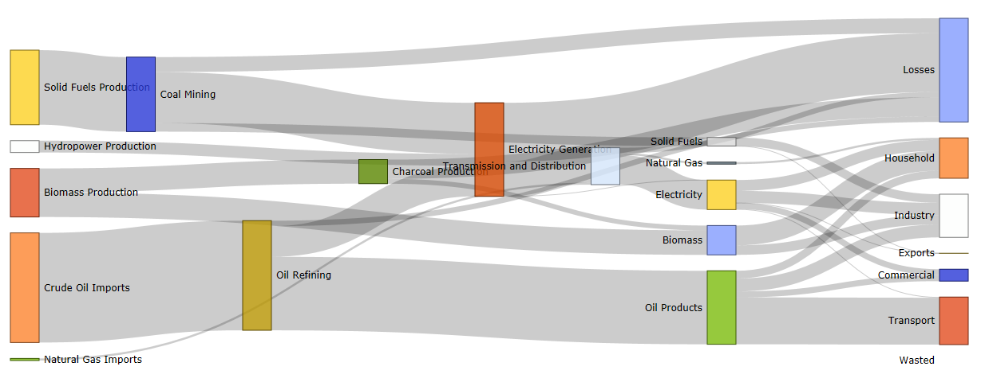
Energy Action Plan for West Bengal
Work Package-III: Baseline Assessment
1
2
3
4
Systemic Review of Existing Policies / Schemes
Preparation of Responsibility Matrix
Energy Profiling of State
Baseline Assessment – Preparation of Base Year Energy Balance Sheet
Mapping of Global goals (SDGs & INDCs), National-level policies and their interconnectedness with State Policies, Schemes and Action Plans¹
Consultation with nodal departments responsible for implementing flagship schemes /interventions of GoWB
Identifying departmental linkages and defining roles & responsibilities
Preparing the energy flow diagram for the State
Energy supply, demand and consumption pattern disaggregated across sectors using tree diagrams
Setting benchmarks for measuring progress on the energy modelling tool
Preparing Energy Balance Sheet in the form of a Sankey Diagram
Tree Diagram
Sankey Diagram
Illustrative
Illustrative
Deliverable D3: Base Year (2017) Energy Balance Sheet
Notes:
1-Annexure

Slide 18
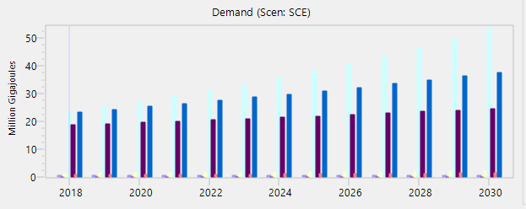
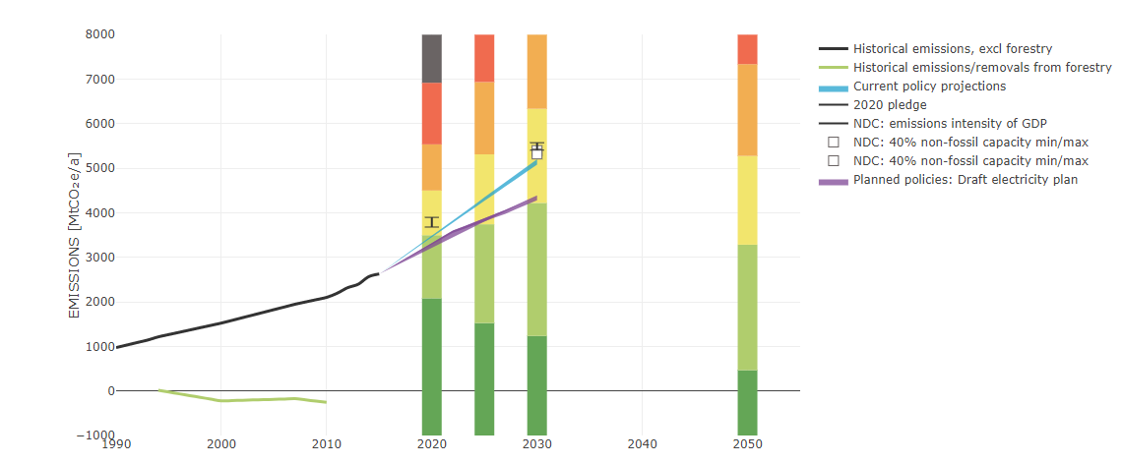
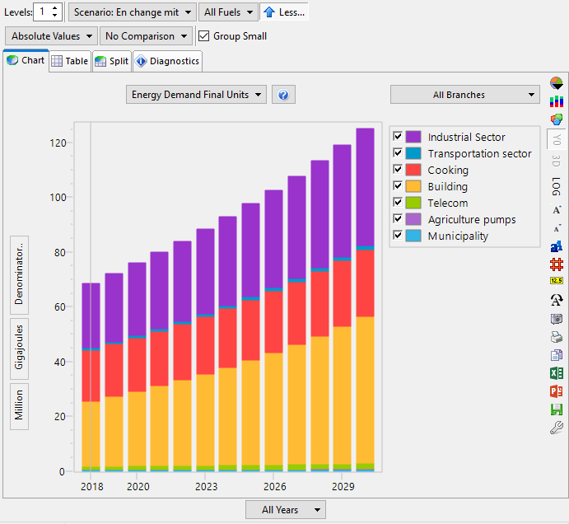
Energy Action Plan for West Bengal
Work Package-IV: Long-term Scenario Assessment
1
2
3
4
Gap Analysis
A gap analysis shall be conducted to quantify the difference between the vision set after consultation with the team and the baseline established
Constructing Long-Term Scenarios
Our team proposes to construct 5-7 scenarios after consultation with beneficiary departments of GoWB and PMU members
Scenario Analysis
Forecasting the outcomes of each scenario independently (direct inheritance from baseline scenario) and in combination with each other (multiple scenario inheritance)
Policy Outcomes
Constructing least-cost optimization models and conducting cost-effectiveness analysis to determine future strategies
Training / Capacity Building of PMU members using detailed manuals
Quantifying Gap between Targets and Baseline
Least Effort
Scale up & Deploy
Short of existing policy targets
Energy Efficiency in industry
Renewable electricity
Determined Effort
Business-as-usual Scenario
Illustrative
Market Transformation
Aggressive Effort
Zero-emission LCVs
Methane capture
Exploring inter-departmental synergies
Heroic Effort
“Reach” Technologies
Exploring inter-departmental synergies
Advanced biofuels
Zero-emission HCVs
Optimal Effort
Likely to be achieved
Deliverables: Detailed Report on Baseline Generation, Outcomes of Scenario Building, Training / capacity building activities, software model(s) along with scenarios, users’ manual
Notes:
“Reach Technologies” being those that have not been commercially proven yet but will likely be necessary to help meet the 2050 greenhouse gas goal, and to mitigate the risk of other greenhouse gas reduction solutions falling short

Slide 19
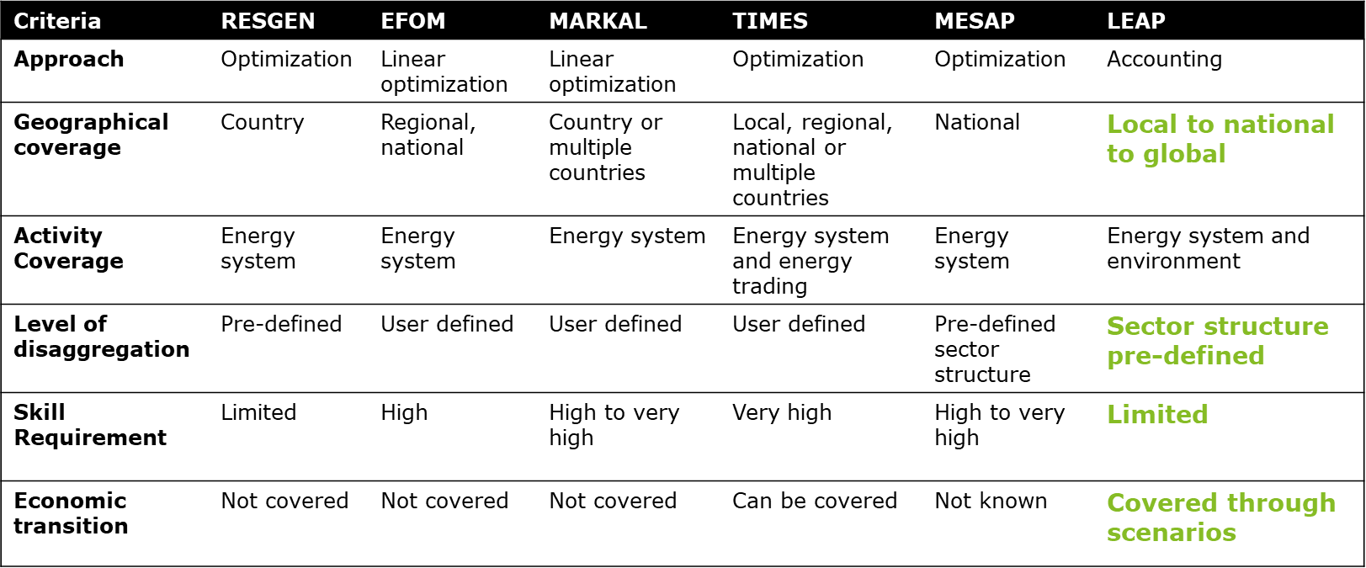
Energy Action Plan for West Bengal
Work Package-V: Decision Support Tool and Energy Calculator
“
Our proposed team has extensive experience in using different energy policy modelling tools and from our preliminary analysis we recommend the use of Long-Term Energy Alternatives Planning System (LEAP) for preparation of West Bengal State Energy Plan and Energy Action Plan.
”
Advantages of LEAP
Interconnectedness of State policies /targets with national targets
Disaggregation of demand possible
User-friendly with in-built dashboards
Scenario building & scenario analysis possible
Development of Interface
Building Energy Calculator
Calling LEAP
LEAP can be used in the backend by other windows programs using API (Application Programming Interface). JavaScript can be used to design a web interface - a user friendly interface for the collection of inputs from the user.
Microsoft’s script editor can be used to access LEAP API. These results can be exported to excel.
The results that are stored in excel files can then be exported directly or could be represented using graphs/charts in the form of energy calculator.

Slide 20
Energy Action Plan for West Bengal
Work Package-VI, VII and VIII: Development, Finalization and Adoption of Energy Action Plan and Ad-hoc Support
Development of Draft Plan
Scale Up & Deploy | 2030 Indicative Metrics | 2030 | 2040 | 2050
Energy efficiency in buildings & industry | Deployment of LED lighting | 3 milllion | 5 million | 7 million
Renewable electricity | Solar generation as % of overall generation | 20% | 30% | 40%
Smart growth | Average Vehicle Miles travelled | 2300 | 2000 | 1800
Market Transformation | 2030 Indicative Metrics | 2030 | 2040 | 2050
Zero-emission light duty vehicles (ZEV) | Sale of Electric Vehicles | 2 million | 6 million | 8 million
Fluorinated (F)-gas replacement | Replacement of F-gases used as refrigerants | 10% | 20% | 30%
“Reach” Technologies | 2030 Indicative Metrics | 2030 | 2040 | 2050
Advanced sustainable biofuels | Commercial-sale biofuels | 10% | 20% | 30%
Zero-emissions HCVs | % of Electric buses | 10% | 20% | 30%
Illustrative
Finalization and Adoption of Energy Action Plan
The Draft Plan shall be discussed with all relevant stakeholders
Stakeholder consultation workshop to be organized on the theme: Final workshop and Way Ahead
Our team shall respond to queries of different stakeholders and defend the plan
AD-HOC SUPPORT
Ad-hoc support as per the requests received by GIZ from the state partners for meeting the objectives of EP and EAP
A dedicated pool of resources have been proposed to support the execution of this assignment and ensure successful delivery
Notes:
“Reach Technologies” being those that have not been commercially proven yet but will likely be necessary to help meet the 2050 greenhouse gas goal, and to mitigate the risk of other greenhouse gas reduction solutions falling short

Slide 21
Detailed Work Plan
An estimated timelines for each key activities under various work packages, key deliverable, major workshops have been identified

Slide 22
04
Resource Plan Strategy

Slide 23
Resource Engagement Framework
To cater to the integrated requirements for Development of EAP, we will employ a robust team with expertise of diversified dimensions
Technical Expert from the GIZ- IGEN- Access Programme
Reporting
Resource Pool of Consultants
Set overall direction
Review outputs and provide inputs / feedback
Make key decisions and approve recommendations
Key Experts
Pool of Experts
Team Leader – Expert 1 (integrated energy planning and modelling)
Expert 2 (energy planning, modelling and economics) & Co-leader)
Local co-ordinator cum liaison expert
Shubhranshu Patnaik, Deloitte
Lakshmi Alagappan, E3
Sayantan Banerjee, Deloitte
PMU Team
Expert 3 (Energy Policy/Plan)
Expert 4 (Expert on renewable energy and climate change)
Technical Expert
Department of Power and NES
Anish Mandal, Deloitte
Dr. Indrajeet Singh, Deloitte
Tory Clark, E3
Other Govt. Departments
Back stoppers
Pool of Technical Expert
Back Stopper – Technical Expert & Policy
Pool of Technical Expert
Provide support to the consultant in developing work plan, policy review, baseline assessment and other inputs required for developing EAP
Amit Goenka, Deloitte
Dr. Fredrich Kahrl, E3
Anirban Bandyopadhyay, Deloitte
Develop the EAP of the State and Perform the tasks underlined in the various work packages, conduct trainings and workshops, accord approvals along with support in Ad-hoc tasks

Slide 24
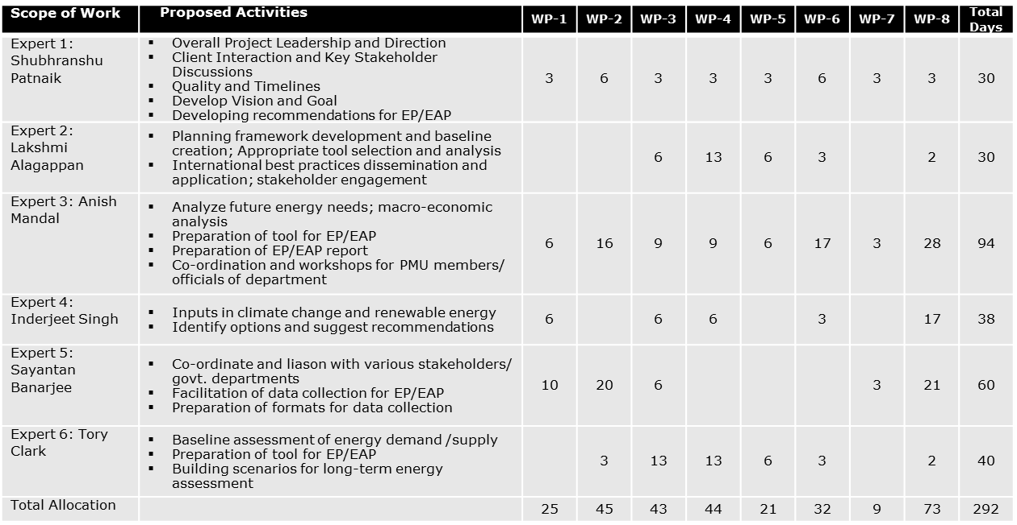
Resource Engagement Framework
Mapping the proposed human resources against Work Packages based on the estimated efforts

Slide 25
Thank You!

Slide 26

Key Projects:
Implementation of pilots to assist Central /State govt. in planning for large-scale integration of Renewable Energy
Preparation of Road Map for providing 24X7 Power For All in 10 States in India
Design the Framework for Implementation of Rooftop Solar PV Projects in MP
Developing a White Paper and Draft Solar Rooftop Policy in Gujarat for IFC
Evaluating Institutional Framework for Renewable Energy deployment in India
Team Leader – Expert 1
Shubhranshu Patnaik
Partner, Deloitte India
22 years of experience
Shubhranshu is a Partner with Deloitte, India and has led several assignments in energy sector with focus on sector planning, energy modelling, market development, regulatory framework and privatization, public private partnerships (PPP) and project finance in India and abroad. He also brings in extensive experience of working with Central Govt. & agencies on key initiatives such as 24X7 PFA Program, Case-1, Phase 1 of NSM, etc. He has also been deeply involved in some of the contemporary issues with the State Discoms, including UDAY, IPDS & DDUGJY monitoring, smart grid, load flow simulation based planning, etc. Shubhranshu has worked on power sector assignments in UK, Sri Lanka, Nigeria, Bangladesh, Myanmar, Bhutan, Nepal, Turkey, Jordan, etc.
Expert 2 & Co-leader
Key Projects:
Co-led consultancy for the National Association of Regulatory Utility Commissioners’ (NARUC) partnership with India’s CERC on renewable energy
Conducted a regulatory assessment of India’s and Delhi’s policies and developed a regulatory framework to promote distributed energy resources (DER)
Co-authored a study on the needs for planning tools and policies to meet the renewable energy goals in India’s National Action Plan
Lakshmi Alagappan
Director, E3 U.S.A.
10 years of experience
Ms. Alagappan is a Director in E3 and leads the firm’s work in India. She works across the firm’s long-term resource and transmission planning and asset valuation practice areas. Her expertise include regulatory, energy planning, policy, business modelling, etc. She has supported developers and system operators in evaluating the reliability, economic, and policy benefits of high-voltage transmission projects, developed business models for utilities to transition towards integrating higher penetrations of distributed energy resources. In India, Lakshmi has led the development of a regulatory framework to promote distributed energy resources for TPDDL, and co-led a technical and regulatory consultancy to assist CERC with understanding international market designs to facilitate renewable integration.

Slide 27

Key Projects:
Developing the Least Cost Power Generation Plan for Myanmar
Assisted the World Bank Group and Nepal Electricity Authority in development of a Power Sector Viability Action Plan
Assisting CERC in benefits demonstration of a national Px based intra-day market
USAID RISE: Assist the Government of India (GoI) to pilot innovative solutions for enhanced transmission grid capacity to support high penetration rates of RE generation
Expert 3 (Energy Policy/Plan)
Anish Mandal
Director
13 years of experience
Anish is a Director with Deloitte India. He is an Engineer from IIT Kharagpur and MBA from IIM Bangalore and has over 13 years of experience in the Consulting industry with Energy & Resources sector. He has advised clients in areas like Energy Sector Planning, Sector Strategy, Corporate Strategy, Project Appraisals, Energy Policy & Regulatory, Commercial Due Diligence, Energy modelling, Analytics, Valuations, investment structuring, and sector reforms.
Anish has cross country experiences in India, Myanmar, Indonesia, Vietnam, Nepal, Sri Lanka, Bangladesh, and Saudi Arabia working with the Public Sector Utilities, Ministry of Power, Ministry of Coal, Multilateral Banks, Donor Agencies, private investors. PE firms, etc.
Expert 4 (RE & Climate Change)
Key Projects:
Prepared ‘Carbon Market Roadmap for India: Strategy for next Decade’ for GIZ
Assessed GHG mitigation potential of nitric acid in India for GIZ.
Developed comprehensive economic cost benefit 'Framework for Strengthening Investment Climate for Renewable Energy in India’
As Climate Change Modelling Analysis Specialist, carried out Climate risk analysis of Hydropower Project in Nepal
Dr. Inderjeet Singh
Director
18 years of experience
Dr. Inderjeet is a Director with Deloitte based in Delhi. Post completing his Ph.D in Energy Efficiency from IIT Delhi, he undertook his Post Doctoral Research in Climate Change from Germany. He has over 18 years of experience and specializes in policy and regulatory work around market mechanisms, climate change modelling, capacity building, energy simulations, energy efficiency, sustainable development. He leads the Sustainability advisory team in Deloitte. He has extensively worked with bilateral and multilaterals including World Bank, GIZ, ADB, KfW, IGES, etc.

Slide 28

Key Projects:
Assisted the West Bengal State Electricity Distribution Company Ltd (WBSEDCL) on demand projection through econometric modelling and tariff incentivisation for industrial consumers for each consumer category
Assisted DFID and Power Department Govt. of West Bengal in Preparation of West Bengal Renewable Energy Policy and Implementation Framework
Conducted study for optimally restructuring the power utilities of State Government in West Bengal
Local co-ordinator cum liaison expert
Sayantan Banerjee
Director, Deloitte India
19 years of experience
Sayantan is a Director in the Energy and Resources practice of Deloitte India and has over 19 years of experience in the sector. He brings extensive experience of working in the Eastern and North-Eastern part of India as well as neighbouring countries like Bangladesh, Bhutan, Nepal, etc. With his effective project management capabilities, Sayantan has successfully delivered on a number of large energy projects in varied areas including reforms, policy review and drafting, market development, renewable energy, institutional strengthening, financial modelling, etc.
Technical Expert
Key Projects:
Interpreting and representing state and federal regulations in the PATHWAYS mode for evaluating exiting GHG reduction policies for Maryland Department of Environment
Developing LEAP model to create scenarios of energy end-use demands over time and the RESOLVE model to develop optimal electricity capacity portfolios
Managed the team exploring the feasibility, cost etc. of achieving 100% renewable energy in New York
Tory Clark
Managing Consultant, E3 U.S.A.
10 years of experience
Tory Clark is a Managing Consultant with Energy and Environmental Economics with over 10 years of working experience. She joined E3 in 2015 and is a project manager focusing on U.S. state-level climate policy, energy infrastructure planning, and low carbon technologies. She is working on long-term deep decarbonization of US States with an emphasis on accessible and policy-relevant modelling. She has extensive experience in building scenario-based models of energy and climate policies for countries and US States. Several of her projects have focused on helping states chart policy pathways to reach their long-term greenhouse gas reduction goals. She is currently leading projects in New York (NYSERDA) and Maryland (MDE) to evaluate options for reaching renewable energy and climate goals by 2030.

Slide 29

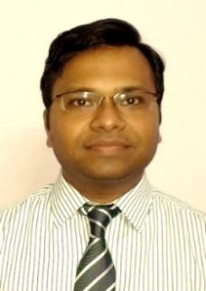
Key Projects:
Co-led project on strategies for improving renewable energy forecasting, scheduling, and balancing in India
Led study on the future of electricity resource planning in the U.S., as part of Department of Energy-funded Future Electric Utility Regulation Series
Advised SERC research team on modelling strategies for electricity sector GHG policies, wind integration policy, and electricity rate design, funded by RAP
Back Stopper - Technical Expert & Policy
Dr. Fredrich Kahrl
Energy and Environmental Economics, Inc.
10 years of experience
Dr. Kahrl leads E3’s research and international work. He has more than 10 years of experience in the energy sector, providing strategy and analytical support to government agencies, energy regulators, research organizations, foundations, system operators, utilities, and energy producers.
Dr. Kahrl has worked extensively with different levels of governmental agencies in U.S.A. and China on Renewable Energy Integration, Resource Planning, Energy Modelling, GHG Accounting.
Technical Expert
Key Projects:
Preparation of Roadmap for developing 24*7 Power for All in Himachal Pradesh
Study on Impact of Transmission & Distribution projects on Electricity Access for World Bank
Technical and Financial Feasibility Study for setting up manufacturing of 1000 MW Ingot Growing and Wafering facility to Central Electronics Limited
Review of Lessons Learnt from DFID India support for Power Sector Reforms over 20 years
Amit Goenka
Sr. Manager, Deloitte India
13 years of Experience
Amit Goenka, a Senior Manager at Deloitte has over 13 years of professional experience. He has worked with the several power sector utilities and regulatory commissions in the country and has a rich experience across various policy and regulatory assignments. He has also worked across number of other areas within power sector including bid process management, financial feasibility study, renewable energy and reforms. Amit has also worked on impact assessment of electricity access and led several projects in business planning and tariff design for power sector utilities in the country.

Slide 30
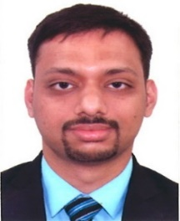
Key Projects:
Assisting the West Bengal State Electricity Distribution Company Ltd (WBSEDCL) on retainership basis for past 3 years in filing of MYT Petition, FPPCA Petitions and APR Petitions
Support to USAID and Government of Nepal in hydropower development and power sector reform in Nepal
Support to Asian Development Bank for development of institutional strategy for setting up cross border power trading entities in Bangladesh and Nepal
Technical Expert
Anirban Bandyopadhyay
Sr. Consultant, Deloitte India
10 years of experience
Anirban, a Senior Consultant with Deloitte Consulting’s Energy and Resources practice has around 10 years of professional experience. He has worked on several areas in power sector with multilateral organization, regulatory bodies, public sector power utilities, industry bodies and private sector organization. His experience in the power sector spans across wide range of services including regulatory filing, financial modeling, power sector policy review, power demand-supply forecast, business plan, capacity building and institutional strengthening. He has worked on several assignments with distribution and transmission utilities in West Bengal. Anirban has also been involved in a multitude of projects outside India including Bhutan, Nepal, Bangladesh, Sri Lanka and Maldives.

Slide 31
Use Case in LEAP
West Bengal Long-Term Energy Planning Model

Slide 32
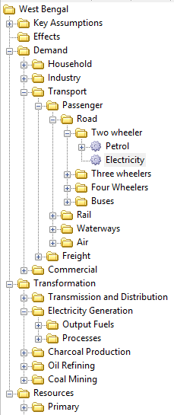
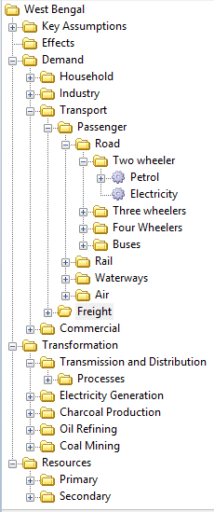
LEAP Framework – The Data Tree
LEAP is a scenario-based energy-environment modelling tool
LEAP performs comprehensive accounting of how energy is produced, converted and consumed in a given economy under a range of alternative scenarios
RESOURCE – Total Primary & Secondary Energy Supplies
TRANSFORMATION
Illustration in LEAP
1
DEMAND – Final Energy Consumption
2
Key Components of Data Tree in LEAP
Independent Variables that drive Demand, Transformation & Resource Analyses
Can be created and organized as required
1
Key Variables
2
Demand
Disaggregated data structure of energy demand analysis
3
Transformation
Data structure of conversion and transportation of energy forms
Module level and process level
3
Resources
Data structure for indigenous production and import/export of secondary fuels
4
4

Slide 33








LEAP Vocabulary – Key Concepts for Building Data Structure
Category
Technology
Fuel
Environmental Loading
Demand Analysis | Used for organizing sectors, sub-sectors and end-uses | Used to represent final energy consuming devices | - | Represent the emissions of a particular technology combined with its fuel type
 |  |  | -
 | Flexible | Flexible | - | Flexible
Transformation Analysis | Used for energy conversion modules and organize various processes and output fuels | Used to indicate processes | Represents the various output fuels produced by each transformation module | Represent the emissions of a particular transformation process based on feedstock fuel type
 | Not Flexible | Not flexible | Not flexible | Flexible
Resources | Used for organizing primary resources and secondary fuels | - | Represent primary and secondary fuels produced, imported or exported in the area | -
 | Not Flexible | - | Not flexible | -
NO_{x}
CO₂
CO
NO_{x}
CO₂
CO
Key Variables are used as independent time-series variables that can be referenced in the model (e.g. GDP, population, industrial output, population etc.)

Slide 34
Demand
Step 1: Demand Analysis
Transformation
Resource
Starting point of integrated energy analysis
Demand analysis is a disaggregated, end-use based approach for modeling the requirements for final energy consumption in an area
Demand data structure to be disaggregated into four levels: sectors, subsectors, end-uses and devices
Methods of Demand Analysis
Activity Analysis
Stock Analysis
Transport Analysis
Energy consumption = Activity Level * Energy Intensity
Energy consumption = Stock of Devices * Energy Intensity per Device
Energy consumption = Stock of Vehicles * Annual Vehicle Mileage * Fuel Economy
Energy Consuming Sectors
Sub-Sectors
End-Uses
Devices
Illustration
Industry
Passenger
Road
Two Wheeler
Cooking
Three Wheeler
Four Wheeler
Demand Tree for Transport Sector
Telecom
Buses
Municipal
Metro
Agriculture
Rail
Tram
Buildings
Water
Ferry Services
Transport
Freight*
Air
Air services
Notes:
* Same tree as passenger transport

Slide 35
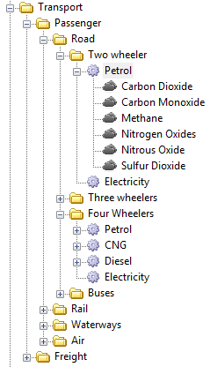
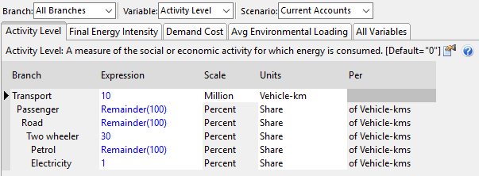
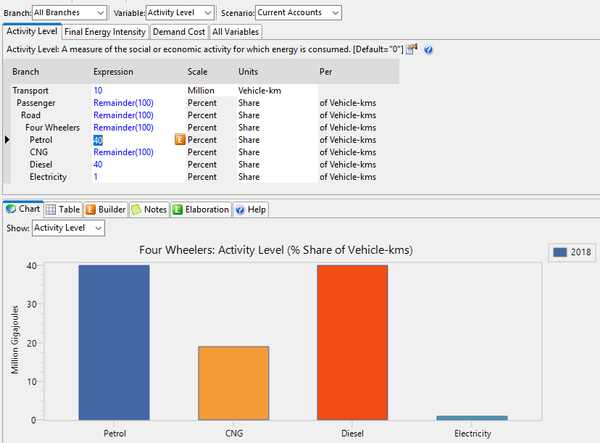
Demand
Illustration: Demand Analysis of Transport Sector in West Bengal using Activity Analysis in LEAP
Transformation
Resource
The overall energy consumption by the transport sector is calculated by LEAP by accounting for the activity levels of each device and its final energy intensity
Besides energy consumption, LEAP can also examine costs and environmental implications using TED
Illustration in LEAP
1. Activity Level
- Measure of social or economic activity (e.g. vehicle-kms for transport)
2. Final Energy Intensity
- Annual final consumption of energy per unit of activity level (e.g. lt of petrol consumed per vehicle-km)
3. Demand Cost
- Costs of energy consuming devices or costs of saving energy (e.g. Rs./vehicle-km)
4. Average Environmental Loading
5. Scenario
- Current Account: Base Year
1
2
3
5
4
Energy demand using these methods is calculated for the Current Account Year (Base Year) and for each future year in each scenario. Each scenario represents different future demand reflecting alternative assumptions about policies and technologies
Notes:
TED- Technology and Environment Database

Slide 36

Demand
Step 2: Transformation Analysis
Transformation
Resource
Transformation Analysis simulates the conversion and transportation of energy forms from point of extraction of primary resources and imported fuels all the way to the point of final fuel consumption
Since transformation calculations are driven by the results of Demand Analysis, ordering of modules will affect the results
Transformation data tree comprises of modules, output fuels, processes (including feedstock fuel and auxiliary fuel)
For each module, capacities, costs and dispatch rule can be specified
Transformation Modules
Sub-Modules
Fuel / Conversion Technology
Feedstock / Auxiliary Fuel
Illustration
Electricity Generation
Output Fuels
Electricity
Residual Fuel Oil
Transformation Tree for Electricity Generation
T & D
Processes
Existing Oil
Existing Coal Steam
Coal Bituminous
Charcoal Production
New Wind
Wind
Oil Refining
Existing Hydro
Hydro
Coal Mining
Existing Solar
New Solar
Solar

Slide 37
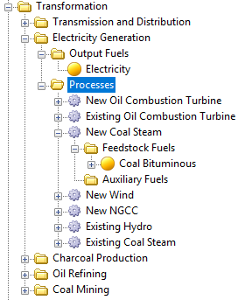
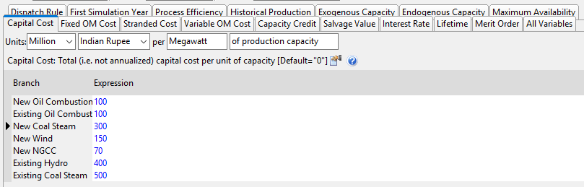
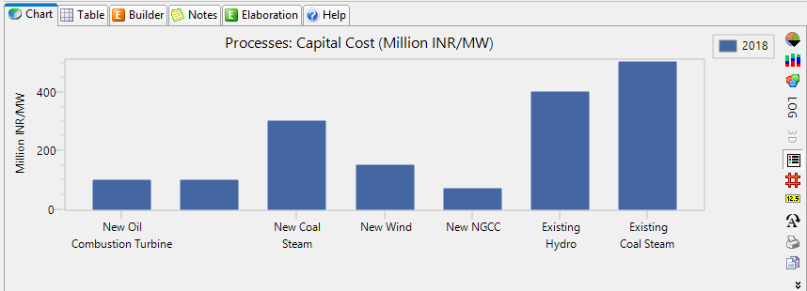
Demand
Illustration: Transformation Analysis of Electricity Generation Module in West Bengal in LEAP
Transformation
Resource
Illustration in LEAP
Transformation calculations are demand-driven. Each module is operated to meet the demands arising from domestic requirement and export demands, if any. The calculation yields the requirement for primary resources, which can be compared to amounts specified in resource branch.

Slide 38
Demand
Step 3: Resource Analysis
Transformation
Resource
Resource Analysis is used to enter data on availability of primary resources, including both fossil fuels and renewable sources as well as information on costs of indigenous production, imports and exports, if any of primary and secondary fuels
List of fuels is automatically updated based on consumption and production patterns in previous two analysis
Costing boundary can be defined for cost-benefit analysis
Resource Analysis
Primary Resources
Secondary Resources
Primary
Secondary
Illustration
Coal Bituminous
Residual Fuel Oil
Natural Gas
CNG
Resource Tree
Crude Oil
Avgas
Wind
Hydro
Solar

Slide 39
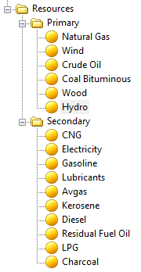
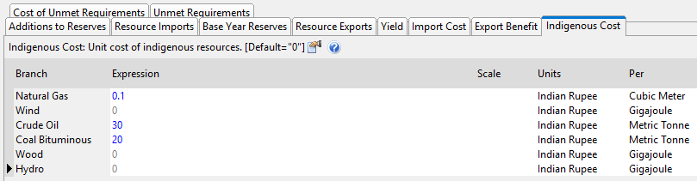
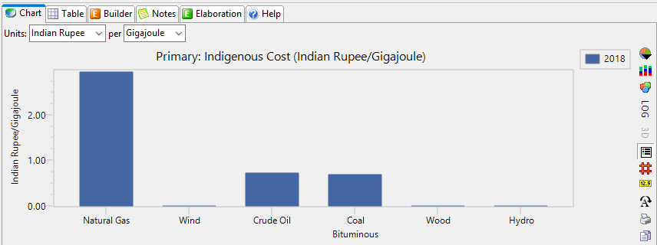
Demand
Illustration: Resource Analysis for West Bengal in LEAP
Transformation
Resource
Illustration in LEAP

Slide 40
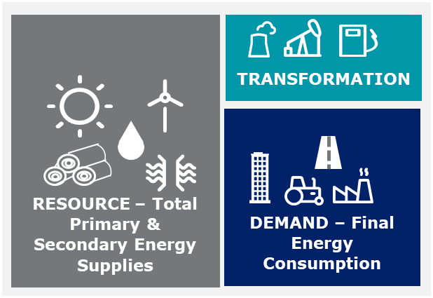
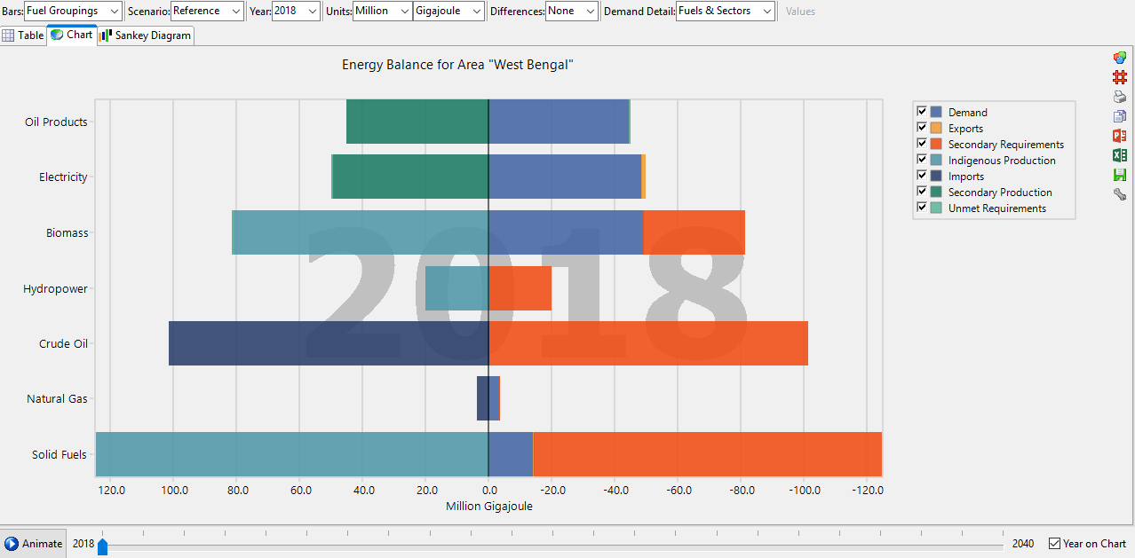
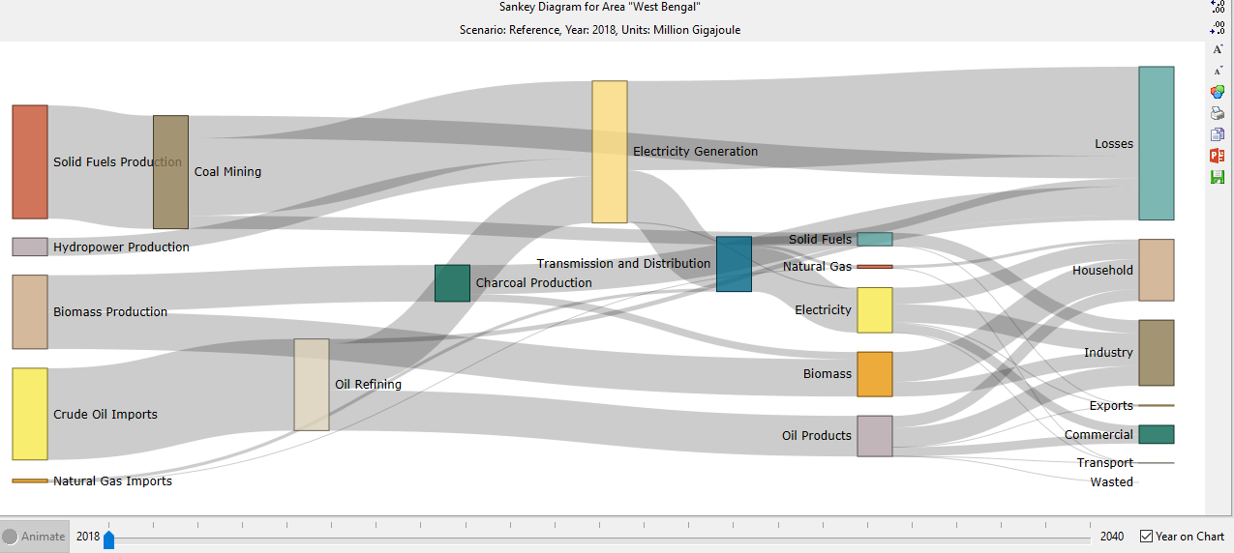
Energy Balance Sheet & Energy Flow Diagram for West Bengal
Based on the LEAP framework defined earlier, LEAP calculates the Energy Balance Sheet of the State using the following matrix:
Illustration in LEAP
Indigenous Production (+) | A
Imports (+) | B
Exports (-) | C
Resources | D= A+B+C
Transformation (outputs – inputs) | E
Demand | F=D+E
Energy Balance Sheet
Energy Flow Diagram (Sankey Diagram)

Slide 41
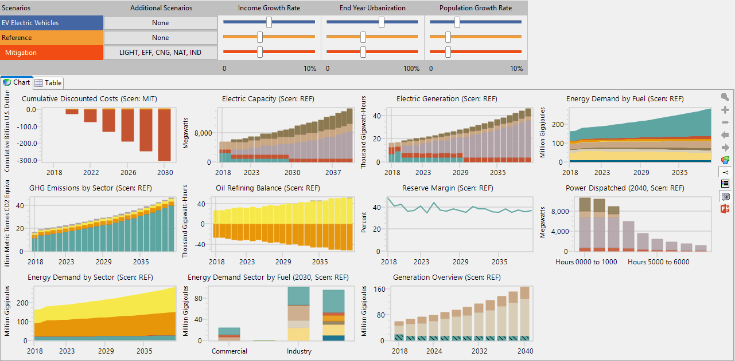
Decision Support Tool
The Overview window of LEAP comes with an embedded decision support tool in the form of a dashboard
The user can customize (add/delete) the graphs/charts/tables added to the dashboard and view the results for different scenarios by moving the scroll bar for various policy levers

Slide 42
Deloitte refers to one or more of Deloitte Touche Tohmatsu Limited, a UK private company limited by guarantee (“DTTL”), its network of member firms, and their related entities. DTTL and each of its member firms are legally separate and independent entities. DTTL (also referred to as “Deloitte Global”) does not provide services to clients. Please see www.deloitte.com/about for a more detailed description of DTTL and its member firms.
This material has been prepared by Deloitte Touche Tohmatsu India LLP (“DTTILLP”), a member of Deloitte Touche Tohmatsu Limited, on a specific request from you and contains proprietary and confidential information. This material may contain information sourced from publicly available information or other third party sources. DTTILLP does not independently verify any such sources and is not responsible for any loss whatsoever caused due to reliance placed on information sourced from such sources. The information contained in this material is intended solely for you. Any disclosure, copying or further distribution of this material or its contents is strictly prohibited.
Nothing in this material creates any contractual relationship between DTTILLP and you. Any mutually binding legal obligations or rights may only be created between you and DTTILLP upon execution of a legally binding contract. By using this material and any information contained in it, the user accepts this entire notice and terms of use.
©2017 Deloitte Touche Tohmatsu India LLP. Member of Deloitte Touche Tohmatsu Limited
Deloitte Touche Tohmatsu India Private Limited (U74140MH199 5PTC093339), a private company limited by shares, was converted into Deloitte Touche Tohmatsu India LLP, a limited liability partnership (LLP Identification No. AAE-8458),with effect from October 1, 2015.

